Slide 1
HYDROELECTRICY
By Naomi Ellul
Form 3 Alpha

Slide 2
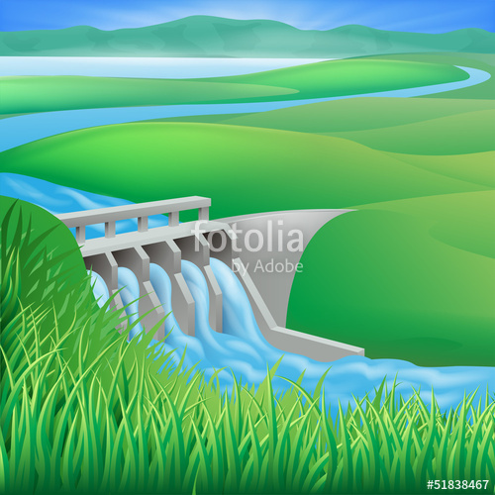
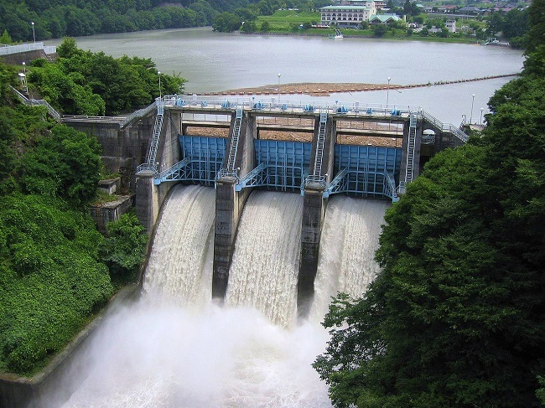
Types of renewable energy
Green or renewable energy is generated from natural sources such as wind, water, rain, sunlight and geothermal heat. One of them is HYDROELECTRICITY which uses water as a source and is generated in hydro-power plants.

Slide 3
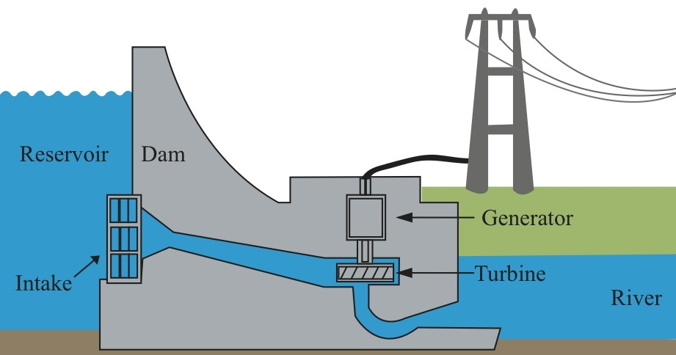
Dam Generator Penstock Turbine Generator Electricity

Slide 4
The process of hydroelectricity
First dams are built to hold back water
As the gates are opened, a small opening of a large reservoir, builds very high water pressure as it flows through the penstock.
A penstock is a pipeline that leads to the turbine, it is designed in such a way that the gravitational force, pulls the water down to the turbine, which produces kinetic energy.
Turbines consist of large fan blades and a spindle, the spindle rotates when the water strikes the blades thus converting kinetic energy to mechanical energy.
Finally there is the generator. The working up in an AC generator depends on Electromagnatic induction. Inside the generator are various mechanical parts which at the end lead to giving us electricity.
Once the water has passed to the turbine, electricity is then passed on to houses, shops, companies, factories and all other buildings which need light to work.

Slide 5
Advantages of hydroelectricity
It is one of the most feasible of all renewable energy options and therefor the most popular.
In terms of reliability and consistency, hydroelectricity is way ahead of its other renewable energy counterparts.
Hydroelectric power is completely independent of fossil fuels or other perishable resources (it doesn’t harm the environment).
A hydroelectric power installation can be beneficial for fish breeding.
It is a clean way of producing energy and the water can be reused for agriculture, irrigation or civic water supply.
Hydroelectricity power stations have a very long life and can generate electricity for many years.
The time required for a hydro power station to shut down and restart is way too less than other power stations

Slide 6
DISAdvantages of hydroelectricity
If there is a lack of rain near the hydro plant, water won’t collect upstream. With no water collecting upstream, less water flows through the hydropower plant and less electricity is generated.
Heavy rain may cause floods, thus causing mass damage to livelihood.
It may lead to adverse ecological effects on its immediate surroundings (it cannot be constructed just anywhere, a proper land examination is a must.
Silt (fine sand / mud) is a problem that may adversely effect the hydroelectric plant.
Finding a suitable place for both the reservoir and the turbine, often becomes a problem.
Earthquakes are a major concern when it comes to hydroelectricity generation.
If it is not planned wisely, a dam construction can amount to wastage of land and displacement of people (more land usage and people will have to be relocated.

Slide 7
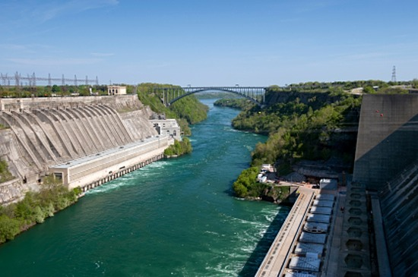
Places that use hydroelectricty
Canada
Brazil
China
United States
Hydroelectricity plant in Canada

Slide 8
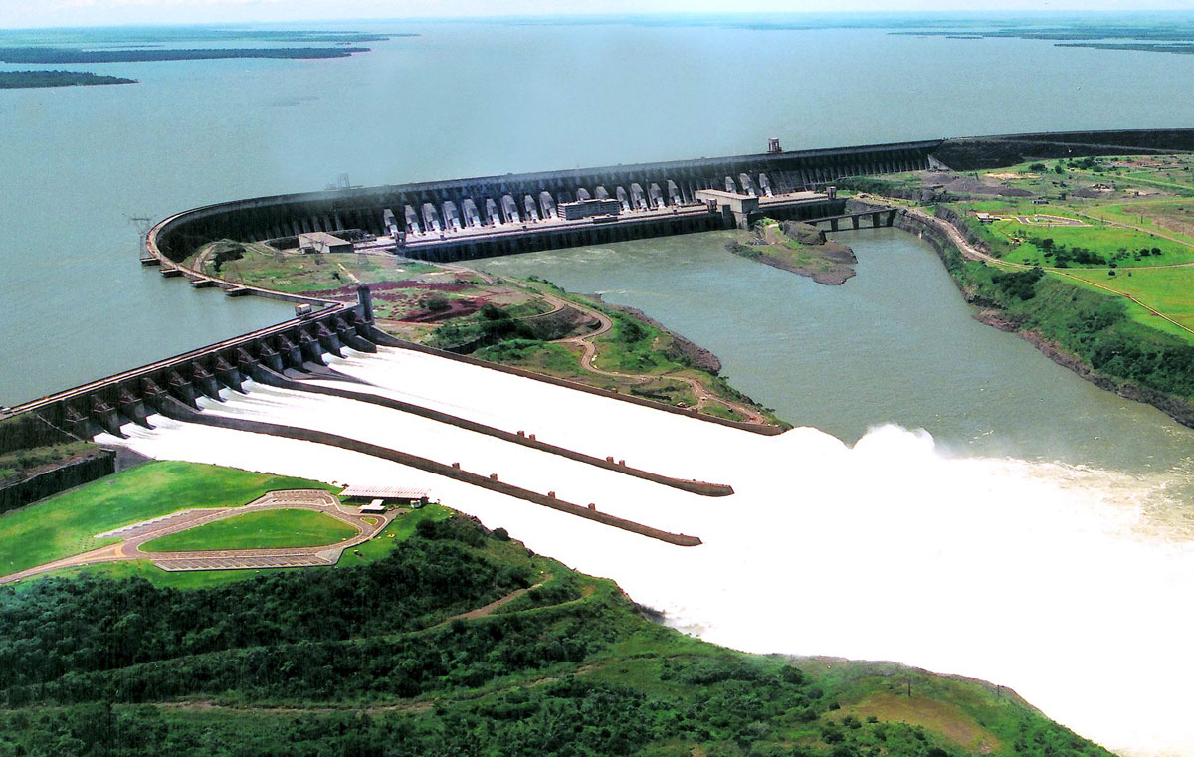
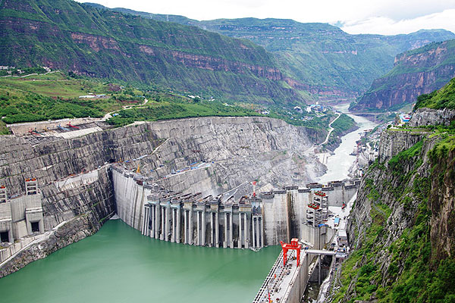
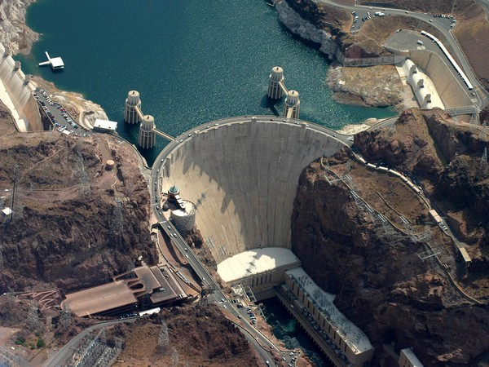
Hydroelectricity plant in Brazil
Hydroelectricity plant in China
Hydroelectricity plant in the United States

