Slide 1
Nuclear Energy
By Shania Mizzi and Julia Sciberras

Slide 2
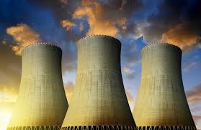
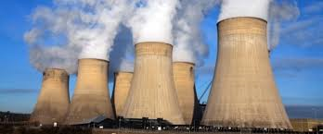
What is nuclear energy?
The core of an atom is called the nucleus. There is a lot of energy in the bonds that hold the nucleus together and this energy can be gained and formed into electricity when the bonds break.

Slide 3
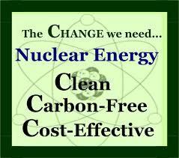
The advantages of nuclear energy.
The advantages is that nuclear energy is a renewable source of energy. It also lowers fossil fuels which lead into less greenhouse gas emissions. Nuclear energy is also the solution to the main problems of renewable energy because the hours of sun or wind does not always coincide with the hours with more energy demand.

Slide 4
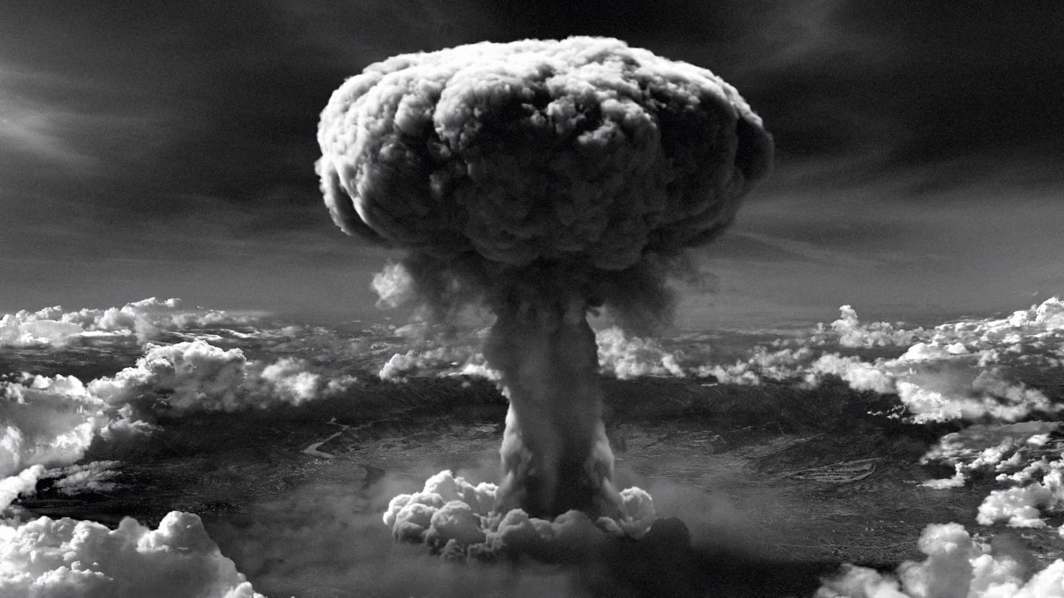
The disadvantages of nuclear energy.
On the other hand there is also disadvantages about nuclear energy! The human mind made bad decisions with nuclear energy just like the Hiroshima bomb which military used it in war and many people died and made a total destruction in the place. The risk that humans still can use it as a weapon is still possible and terrifying.

Slide 5
The Hiroshima bomb
The Hiroshima bomb is one of the disadvantages that people did with nuclear energy. When the bomb was released this is how it worked: After falling the 43 seconds, the time and barometric triggers started the firing magnetism. A uranium bullet fired down a barrel into a uranium tongue together they started a nuclear change reaction. Solid matters began to come apart releasing untold contitism energy.

